Slide 1


Applied Data Science Semester 2 Coursework
Tesco Grocery 1.0 Dataset vs. Income
Background image from: https://www.aqskill.com/the-data-analysis-skill-you-need-2022/
Notes:
Hello everyone,
In this presentation, we will dive into our comprehensive analysis of the tesco grocery dataset that covers various aspects.

Slide 2
Contents
Task 1: Dataset Description
Task 2: Insights Visualisation
Task 3: Combining Datasets
Notes:
We'll start by outlining the scope of the dataset in Task 1, including the types of data collected and the period it covers. Following that, In task 2, we’ll visualise methodologies employed in our analysis to enhance the statistics. Finally in Task 3, we’ll implement external income dataset to compare. Let's begin by examining the structure of the dataset and the initial observations we can draw from the raw data.

Slide 3

Task 1: Dataset Description
A large dataset of grocery purchases in Greater London
- Geo-demographic data
- Food Contents
- Nutrients
- Probability distribution
- Corresponding Energy
- Purchase data
Notes:
Dataset consists of three groups of contents, Geo-demographic data, Food contents about nutrients, categories etc and Transaction data

Slide 4
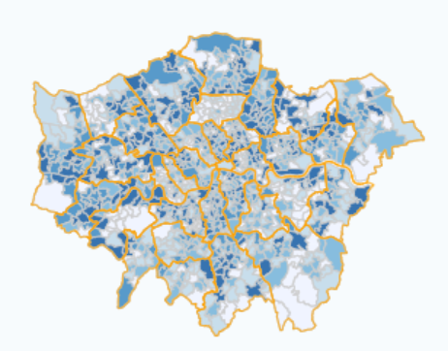
Dataset overview
Purchase record at area levels in 2015
Greater London area
LSOA (Lower Super Output Area)
MSOA (Medium Super Output Area)
Ward
Local Authority, Borough
Defined by Office for National Statistics
https://www.ons.gov.uk/
Notes:
The records hold purchase data of loyalty card owners during 2015 in Greater London Area, in different geographical resolution areas defined by Office for National Statistics.
It includes Lower Super Output Area, Medium Super Output Area, Ward and Local Authority, also called by Boroughs

Slide 5
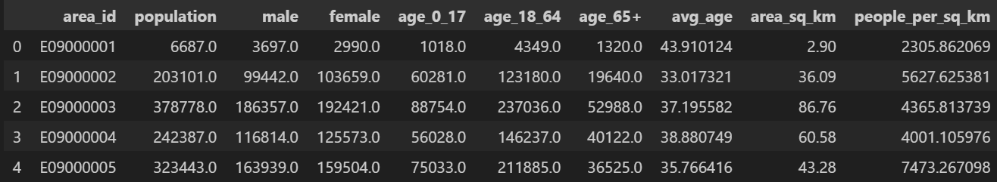
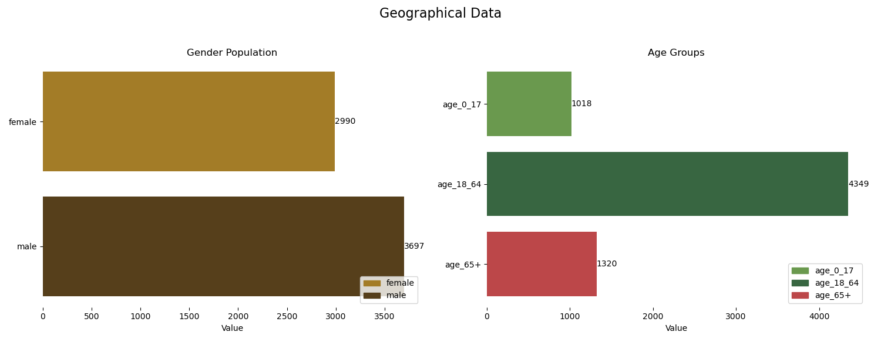
Geo-Demographic Data
Area_id
Population
Average Age
Surface area
Density of Residents
Male
Female
Age Groups
Example of Borough E09000001: City of London
Notes:
First, There are columns demonstrate geo demographic information in 2015 including corresponding area_id, their populations with breakdowns by gender and age groups and density of residents within surface area

Slide 6
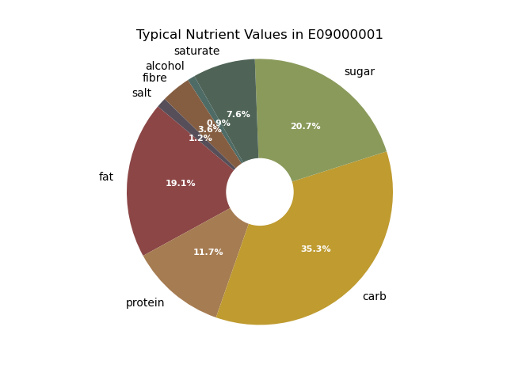
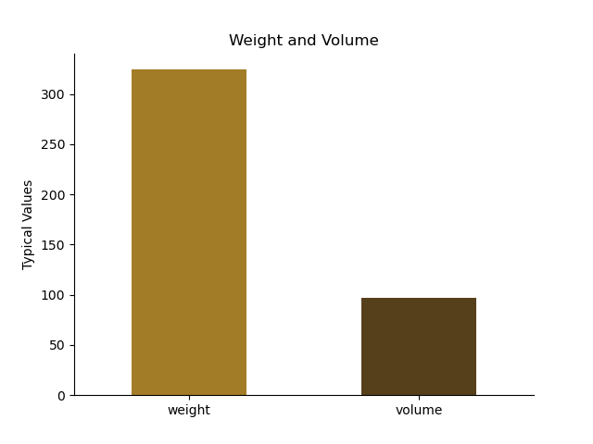
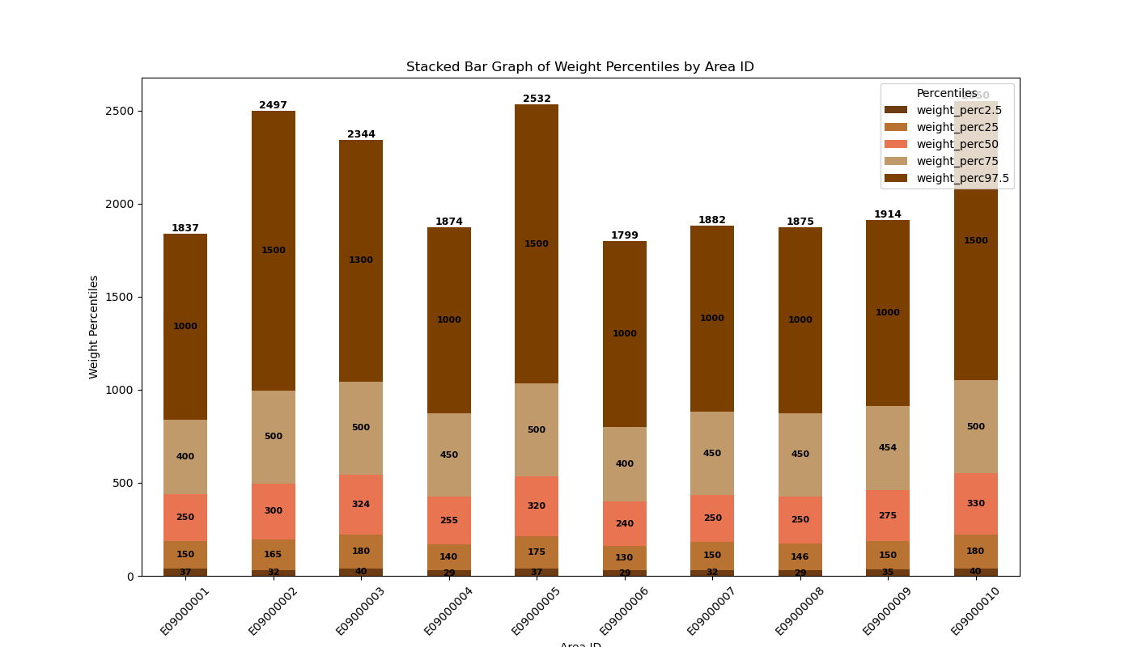
Food contents
Weight & Volume of typical food product and drink product
Percentiles
Nutrients & Percentiles
Fats, saturated fats
Carbohydrates, sugar
Proteins
Fibres
Alcohol
F_nutrients
Probability distributions
H_nutrients
Shannon Entropy
Diversity of nutrients
Notes:
Moving onto Food content data, the weight of food and volume of beverage represent their average of respective products along with percentiles.
Nutrients are recorded in a similar way with percentiles and there exists probability distribution of nutrients in a typical product. Additionally, the Shannon entropy measure is attached to explain the diversity of nutrients

Slide 7
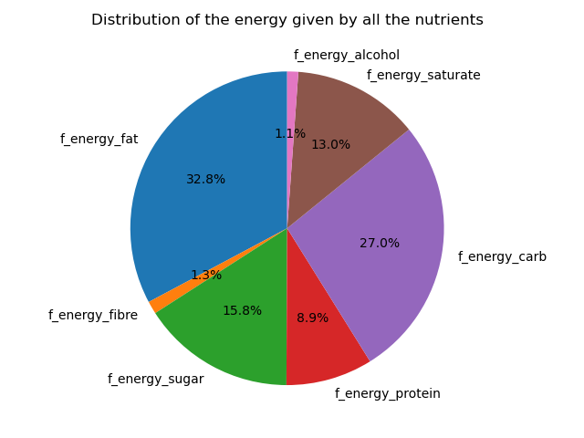
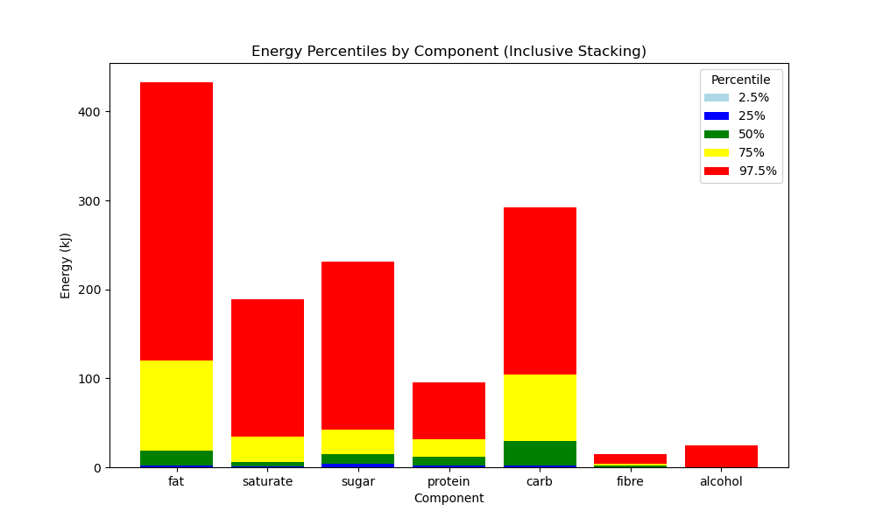
Energy contents in Calories
Typical product’s energy content
Based on the focused nutrients groups
Distribution of the energy given by all the nutrients
Entropy of the distribution of the calories
Fats, Carbs, Proteins, Fibres and Alcohols
Sum of energy
h_nutrients_calories
F_energy_(category)
H_nutrients_calories_norm
Notes:
Based on those Nutrients groups, the energy driven from corresponding nutrients were calculated and stored, providing percentiles and their probability distribution with each entropies

Slide 8
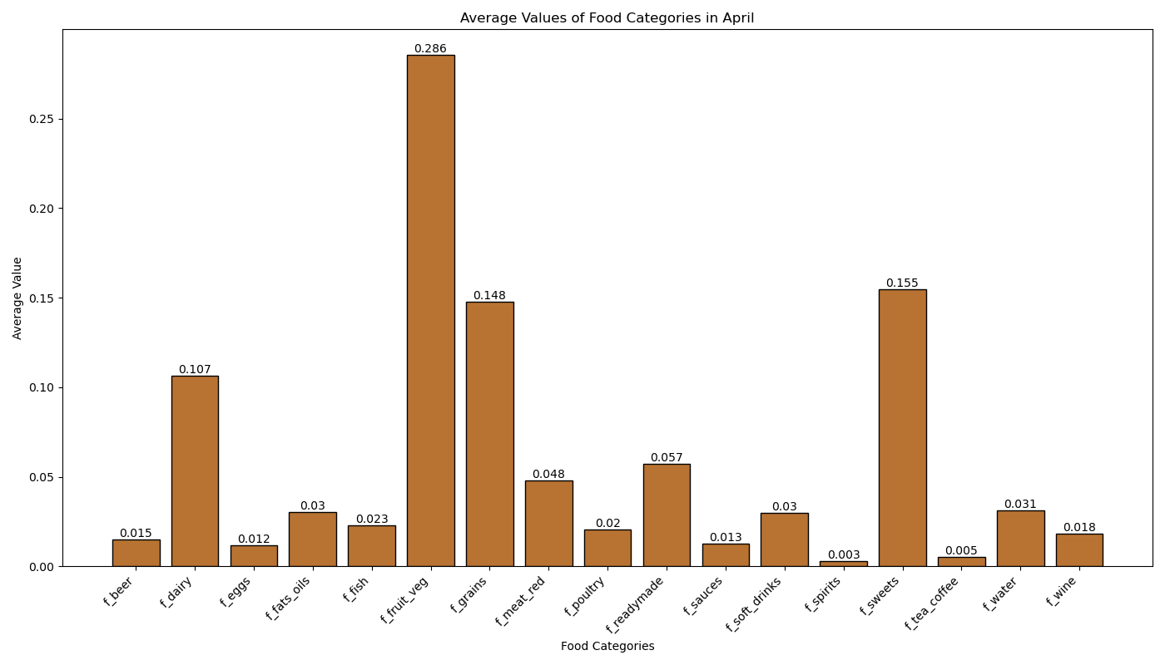
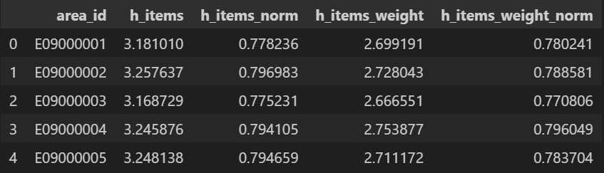
Food Categories
17 representative categories
Food & Beverage
Probability Distribution
Of All categories
Weight of food categories only
Entropy of each category
h_items
h_items_norm
Entropy of food category weights
h_items_weight
h_items_weight_norm
Example distribution of category purchase of Boroughs in April
Notes:
There are columns containing probability distribution of 17 categories consists of beer, eggs, poultry and other columns only holding probability distribution of food weight without drinks.
Again, entropy of each probability distribution were recorded.

Slide 9

Purchase Data
Representativeness
Reliability of the dataset
Ratio: unique loyalty card customer / population
Transaction days
Number of days at least a single purchase is made
Num_transactions
Number of transactions by a club card owner
Man_day
Number of days a customer purchased something
Total of all individuals
Notes:
Representativeness shows the penetration rate of tesco shops in the area. Transaction days, and number of accumulated transaction times and total number of customer purchase days are there.

Slide 10

Task 2: Insights Visualisation
Notes:
Now that we have a solid understanding of the data we're working with, let's move on to the most enlightening phase of our presentation—Insights Visualization

Slide 11

Purchase habit throughout the year
Probability distribution of purchase records
Looking for correlations between category purchase trend
Seasonal
Monthly
Notes:
The first aspect we will explore today is the seasonal trend in purchase data. To do this, I have analyzed the probability distributions of the number of purchases across 17 different categories to identify any correlations between them. I have further segmented the data into seasonal and monthly breakdowns to give us a clearer understanding of consumer behavior in different periods.

Slide 12
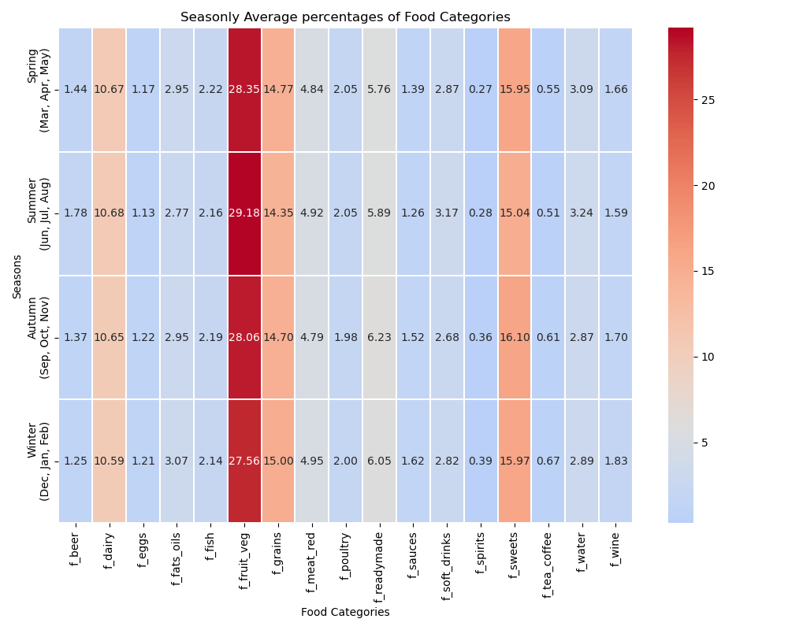
Seasonal Trend in Food Categories
Spring (Mar, Apr, May)
Summer (Jun, Jul, Aug)
Autumn (Sep, Oct, Nov)
Winter (Dec, Jan, Feb)
Probability distribution heatmap
Fruit and Vegetables remain most sold
Spirits remain least sold
Notes:
This heatmap provides a broad view of the seasonal probability distributions, highlighting a general trend where purchases in the Fruits and Vegetables category are predominantly higher, while Spirits are the least purchased. This visual representation allows us to quickly discern which categories are most and least popular across different seasons.

Slide 13
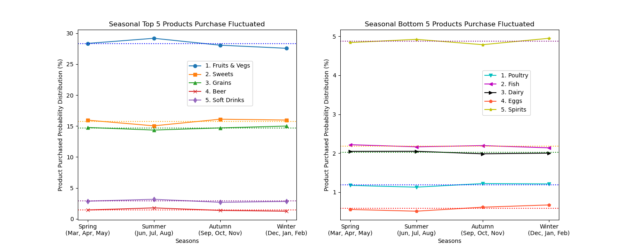
Fluctuations in trend
Variance
Top 5 and Bottom 5
Visible correlations between Fruits & Vegs and Sweets
Break down into Monthly level
Notes:
To effectively identify correlations, we need to observe noticeable changes in purchasing patterns throughout the year. Therefore, I selected the top five categories that show the highest variance. This approach helps us pinpoint where the most significant shifts in consumer behavior occur, enabling a more focused analysis of correlations between these categories.

Slide 14
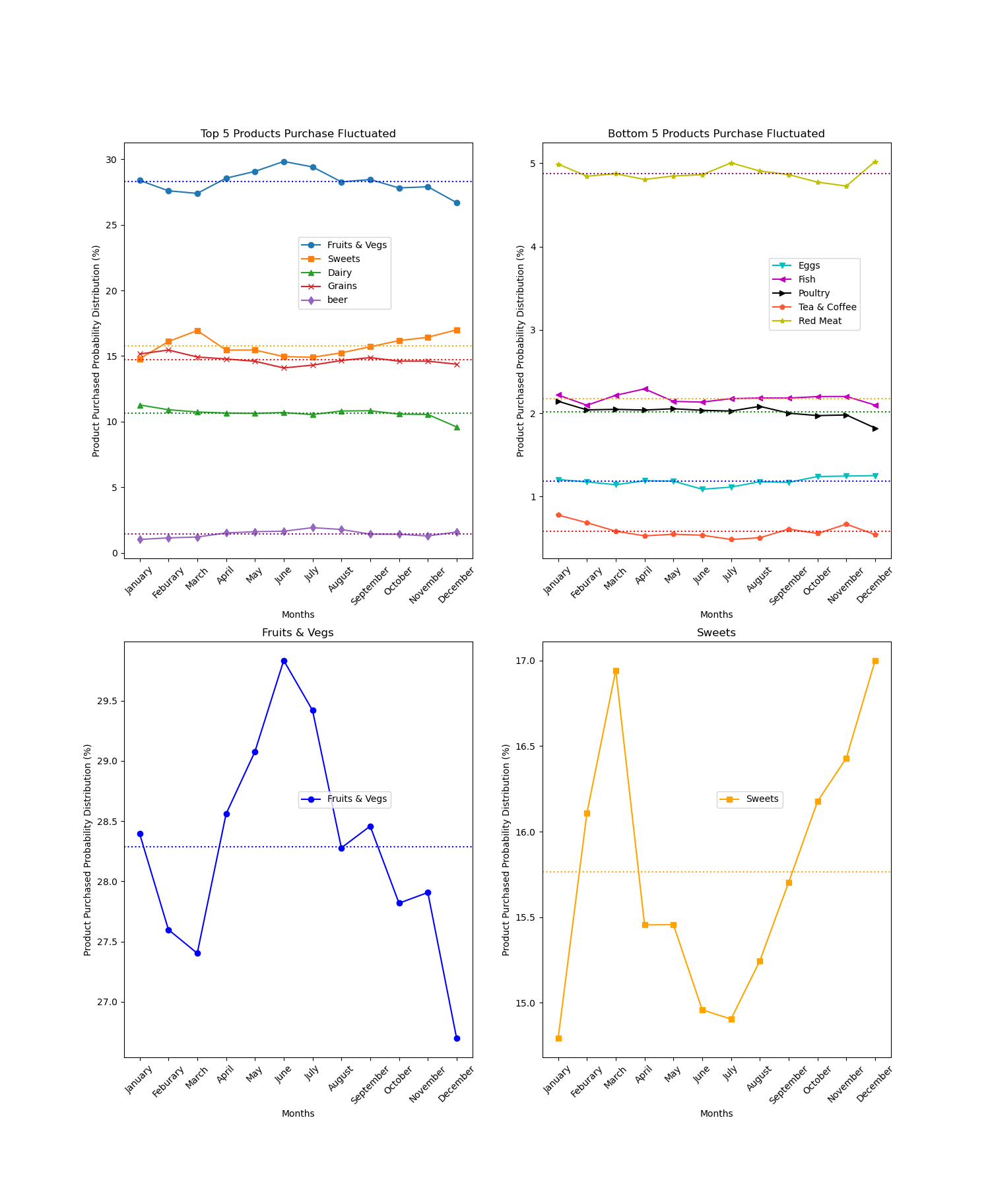
Trend on Monthly Level
Represents clearer correlations
Fruits & Vegs
Sweets
Noticeable negative correlation
Fruits & Vegs
Peak during summer June and July
Minimum in December
Sweets
Peak in December
Bottom in June and July
Notes:
Upon analyzing the data at a monthly level, clearer visual correlations were discovered. Notably, an interesting relationship emerged between the Fruit & Vegetables and Sweets categories, showing a negative correlation. To illustrate this trend, I plotted line graphs that compare the monthly purchasing patterns of these two categories, revealing how their sales could inversely affect each other.

Slide 15
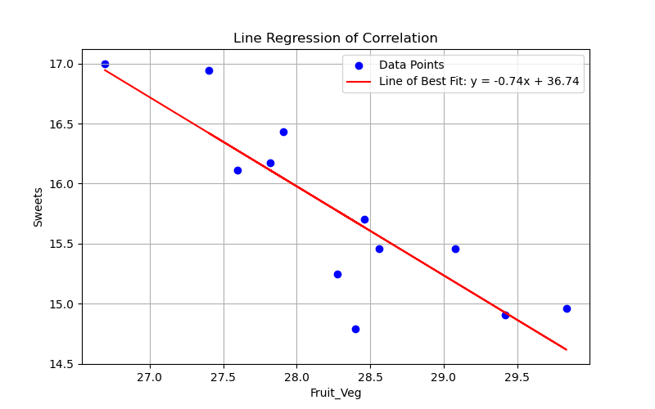
Regression
Plot distribution values corresponding
Fit the line of regression
Negative correlation
When the number of purchase on Fruit and Vegetables category increases, the sweets demand falls.
Opposite
Pearson Correlation Coefficient
Correlation between columns f_fruit_veg and f_sweets: -0.855
Correlation between columns f_grains and f_beer: -0.774
Correlation between columns f_dairy and f_grains: 0.565
Correlation between columns f_sweets and f_dairy: -0.564
Correlation between columns f_fruit_veg and f_beer: 0.465
Notes:
Using the monthly data points, we conducted a regression analysis and added a line of best fit to clearly demonstrate the negative correlation between purchases. The analysis conclusively shows that as the number of purchases in the Fruit and Vegetables category increases, the demand for Sweets decreases. This inverse relationship is graphically represented to highlight how trends in one category can significantly impact another. Also other interesting correlations were shown below.

Slide 16

Regional Analysis
Yearly averaged purchased record and demographic information
Average age
Gender Population
Area size
Notes:
No that we have established period-wise trend, we can enhance our analysis by incorporating geographical data. This will allow us to examine correlations with demographic characteristics—such as average age, gender distribution, and area size. This step is crucial for understanding how demographic factors influence buying patterns across different regions.

Slide 17
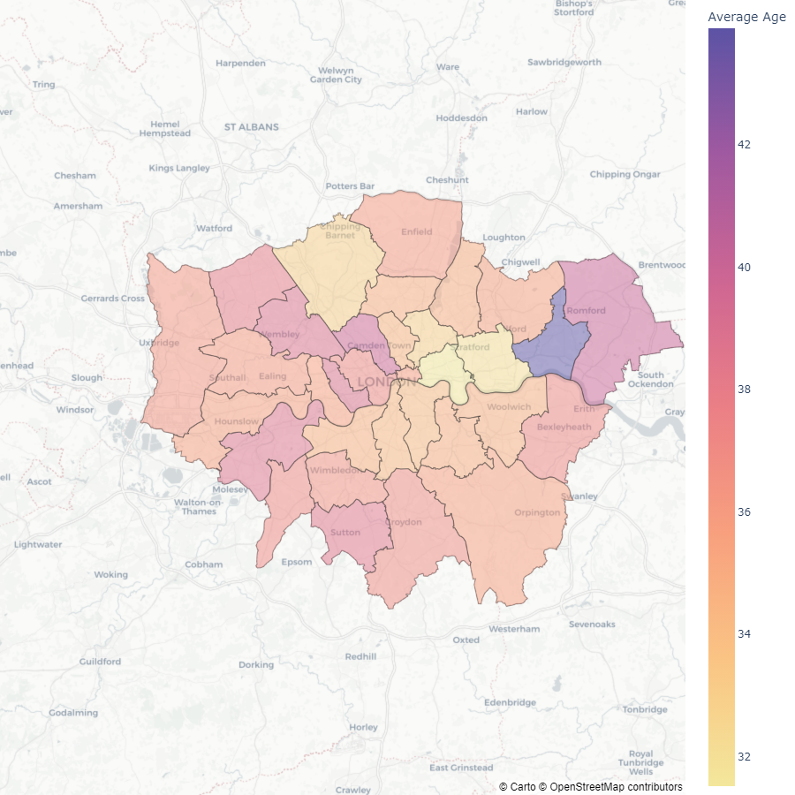
Average age and Food Consumption Weight
36.2
33.0
38.0
35.0
35.0
35.7
38.8
40.1
40.0
34.5
33.0
36.4
32.0
43.9
36.1
37.2
35.9
31.5
Greater London Choropleth map
Heatmap of average age in 2015
Top average age
City of London: 43.9
Minimum average age
Tower Hamlets: 31.5
38.9
34.2
35.7
35.7
34.9
34.8
34.3
37.2
38.7
34.9
36.6
37.1
35.8
38.4
36.9
Notes:
We will now explore how average age affects food consumption patterns. The figure is a choropleth heatmap depicting the average ages across all borough areas of Greater London in 2015. This visual representation highlights the City of London as having the highest average age at 43.9, while Tower Hamlets has lowest recorded average age at 31.5.

Slide 18
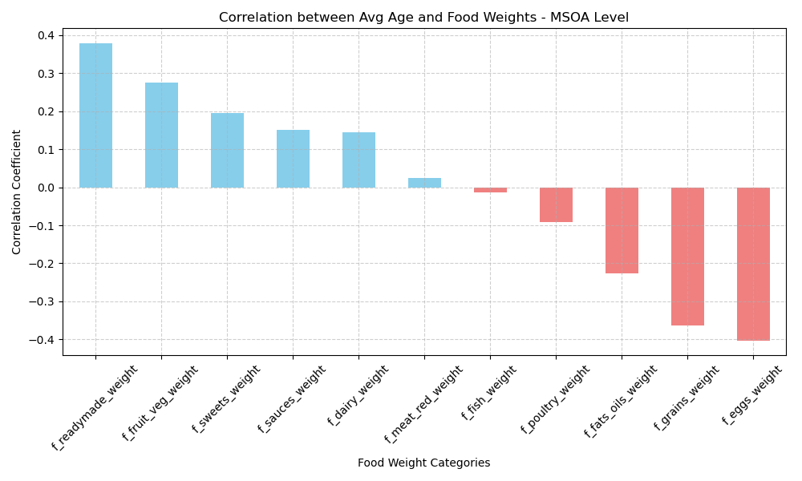
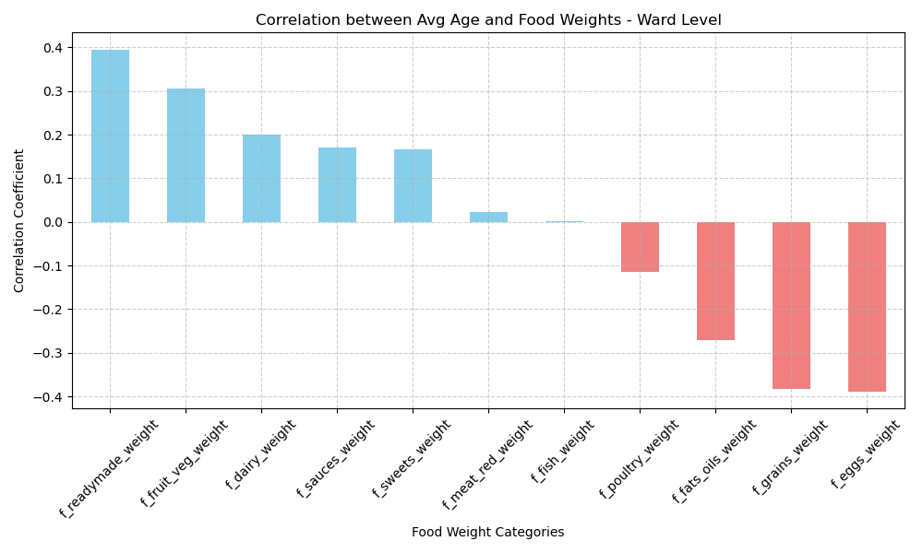
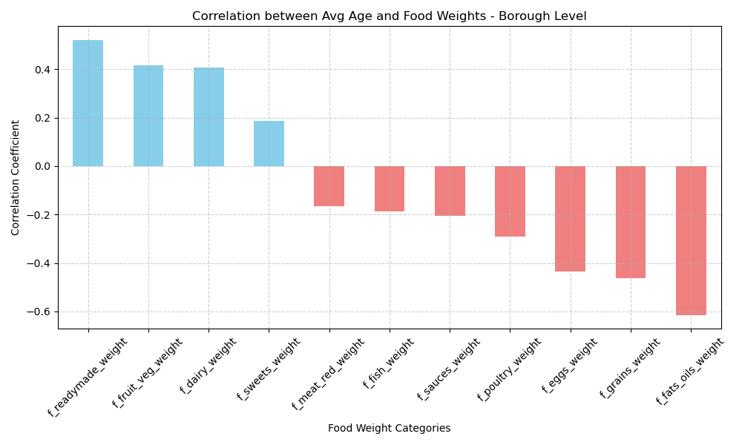
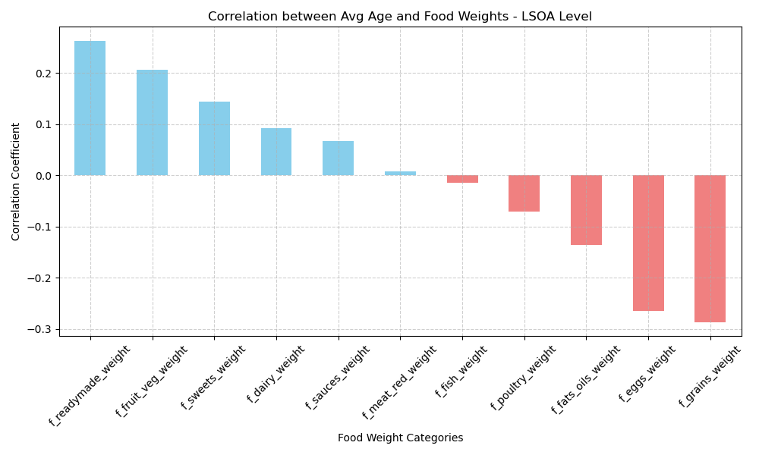
Correlations
Food categories only
Borough
Positive
Higher Average Age
Ready meal: 0.52
Fruit & Veg: 0.41
Negative
Lower Average Age
Fats & Oil: -0.61
Grains: -0.46
MSOA
Positive
Higher Average Age
Ready meal: 0.38
Fruit & Veg: 0.28
Negative
Lower Average Age
Eggs : -0.40
Grains: -0.36
Ward
Positive
Higher Average Age
Ready meal: 0.26
Fruit & Veg: 0.21
Negative
Lower Average Age
Grains: -0.29
Eggs: -0.27
LSOA
Positive
Higher Average Age
Ready meal: 0.39
Fruit & Veg: 0.31
Negative
Lower Average Age
Eggs : -0.39
Grains: -0.38
Notes:
We are now focusing on weight of food consumption, specifically excluding drinks. The first plot reveals the Pearson correlation coefficient, illustrating how food purchasing habits vary with age in borough Level. We observe that boroughs with a higher average age tend to purchase more ready meals and fruits & vegetables. Conversely, in areas with a younger average population, there is a higher consumption of fats & oils and grains.
Also we can find the similar patterns in different geographical resolutions, younger generations consume more eggs and grains.

Slide 19





Insights Summary
Year 2015
Negative correlation in Fruits & Vegetables and Sweets purchase trend.
The Higher average age or the region
Ready meals
Fruits & Vegetables
The Lower the average age of the region
Fats and Oils
Eggs
Grains
Notes:
In the analysis of the 2015 data, we identified a negative correlation between the purchasing trends of Fruits & Vegetables and Sweets. Additionally, it's noteworthy that the average age within an area appears to influence food consumption patterns. areas with an older average age show a preference for ready meals and fruits & vegetables, while areas with a younger population tend to consume more fats & oils, eggs, and grains.

Slide 20

Task 3: Combining datasets
Identify a source of income dataset
Brief overview
Buying behaviour related to income
Notes:
For our final task, we will source a dataset on income and merge it with our current findings to investigate any correlations between income levels and buying behavior. This integrated approach will help us understand how financial factors may shape consumer choices in the grocery sector.

Slide 21
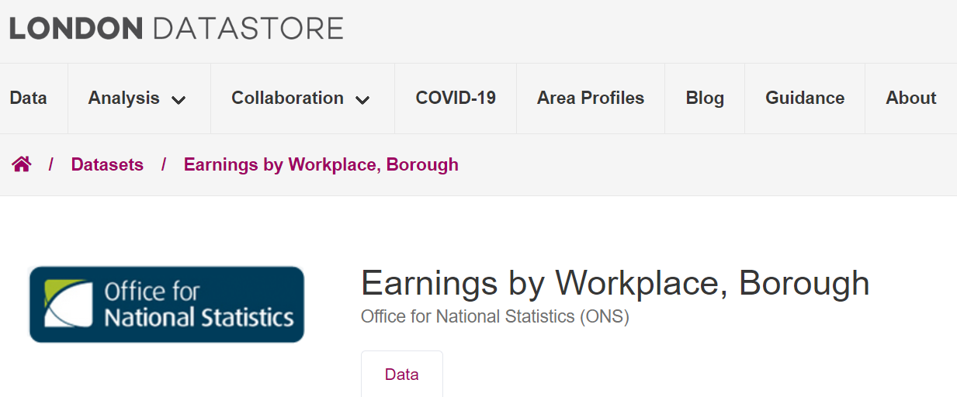
Income Dataset
https://data.london.gov.uk/dataset/earnings-workplace-borough
The London Datastore
Earnings of Employees working in Borough and UK regions
1997 ~ 2022
Fulltime earnings
Gender
Weekly
Annual
Notes:
Through online research, I located a comprehensive income survey dataset published by the Office for National Statistics. This dataset details the earnings of full-time workers from 1997 to 2022, categorized by the boroughs of Greater London as well as other regions across the UK. It's meticulously organized into multiple sheets, offering breakdowns by gender and providing both weekly and annual earnings figures.

Slide 22
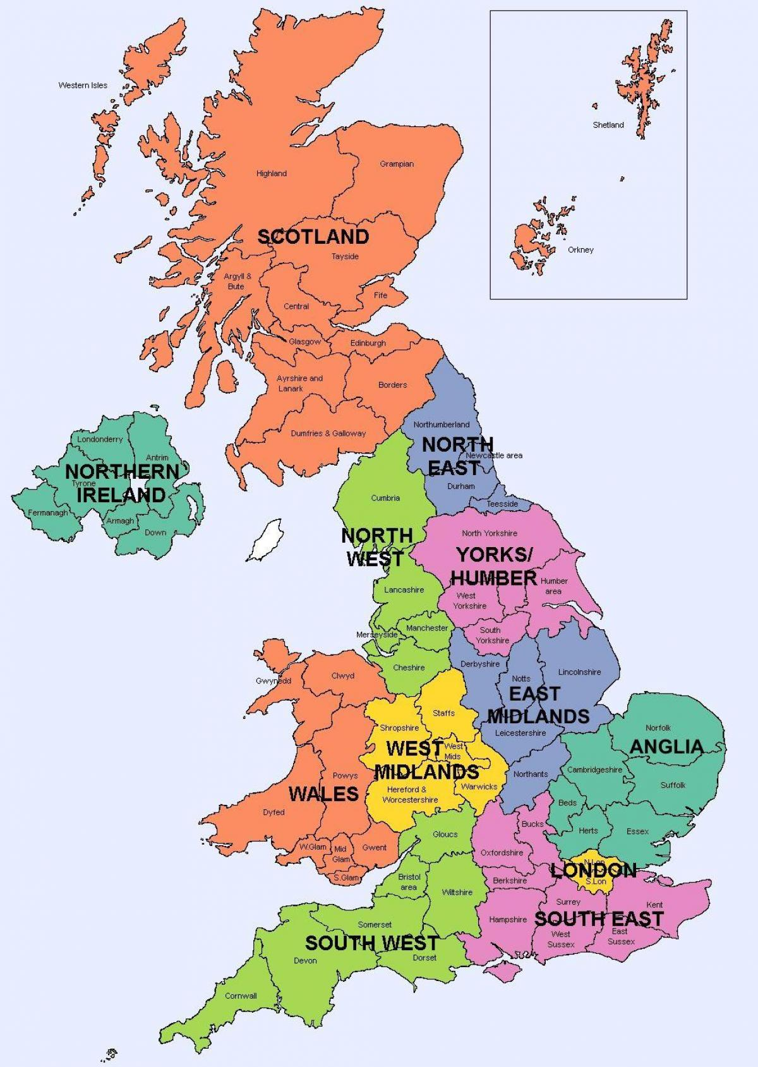
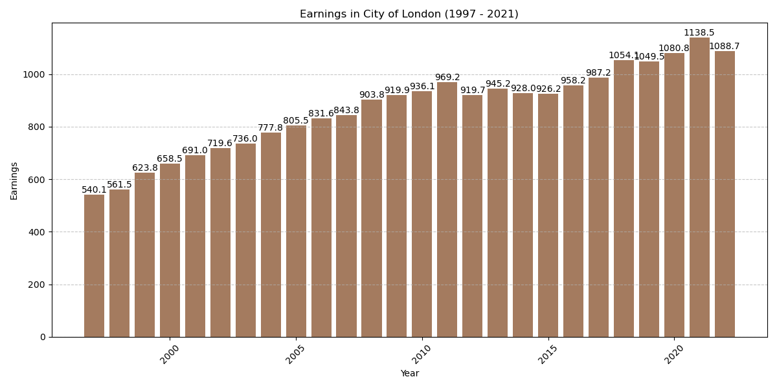
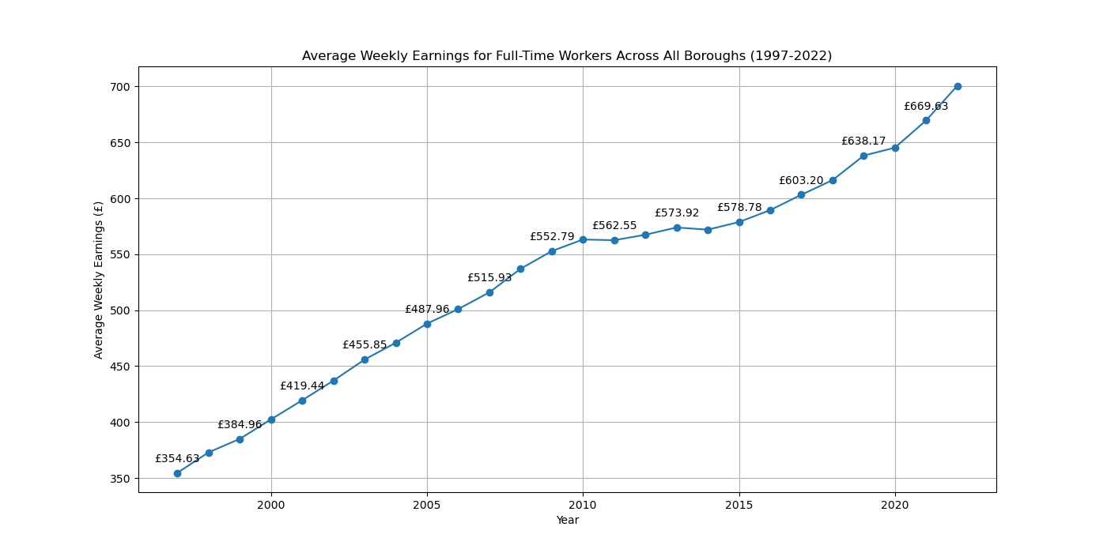
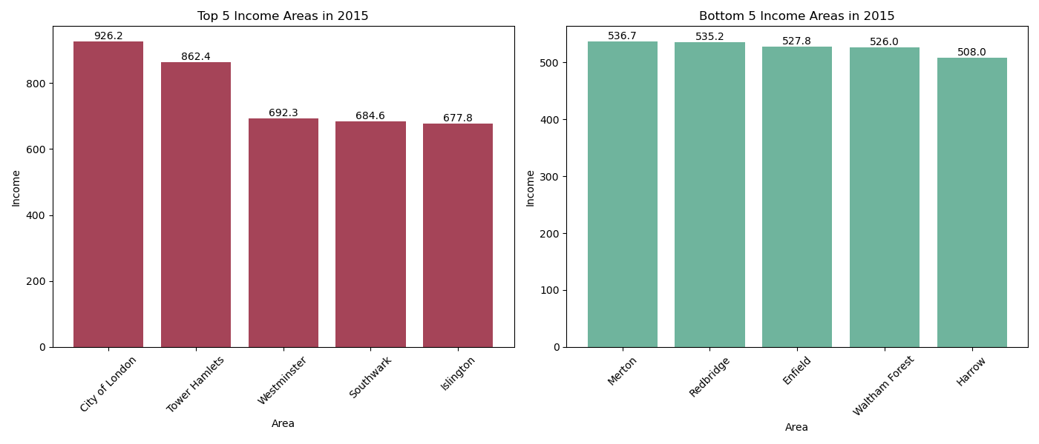
Dataset Overview
33 Boroughs
Northern Areas
Midlands Areas
East
London
Southern Areas
Northen Ireland
Scotland
Wales
England
Great Britain
United Kingdom
8 Spreadsheets
Focusing on All Full Time workers
Average Weekly Earnings
Confidence Figure
Coefficient of Variation (CV)
E09000001, City of London
Top 5 income areas in 2015
Botoom 5 income areas in 2015
Average Weekly Earnings trend
Full time workers
General increase over 25 years
Wage Growth
Economic Events
Region’s policy on empmloyment
Image Source: https://ukmap360.com/united-kingdom-%28uk%29-region-map
Notes:
The dataset we have acquired showcases average earnings across various regions and the boroughs of Greater London. We are only extracting Greater London area.
Figures demonstrate weekly earnings trends in the City of London, along with comparisons of the top five and bottom five income areas in London.
A general increase in earnings is observed over 25 years, averaging wage growth.
Although the line is approximately smooth, sometimes there are periods when the rate of increase slightly straightens or overestimates more noticeably; this may indicate some economic events or changes in the state’s policy on employment.

Slide 23

Income and Purchase habit
Positive relationship between income and dietary patterns
Higher incomes
Healthier food choices
Lower incomes
Restrict access to nutritious options
(French et al., 2019)
French, S.A.,, Tangney, C.C.,, Crane, M.M.,, Wang, Y., and Appelhans, B.M., 2019. Nutrition quality of food purchases varies by household income: The shopper study. BMC Public Health, 19(1).
Notes:
Studies published from BMC Public Health by Simone French and others indicate a positive relationship between income and nutrient intakes, demonstrating the presence of dietary patterns. Wealthier individuals can afford better diets and hence enjoy health benefits; however, inadequate incomes prevent the poor from accessing adequate nutrition, leading to various diet-related illnesses.

Slide 24
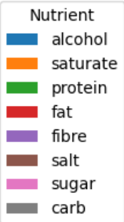
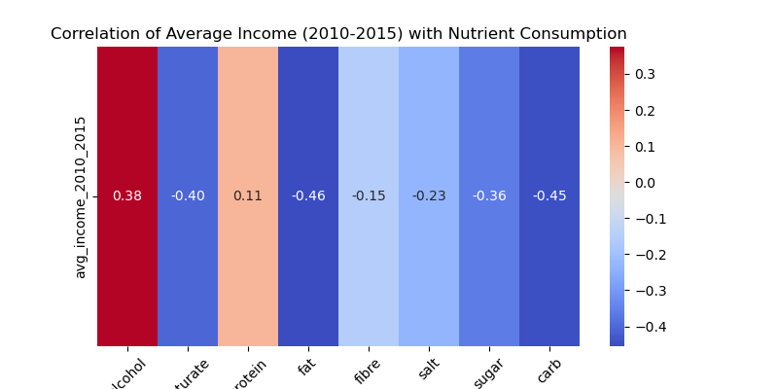
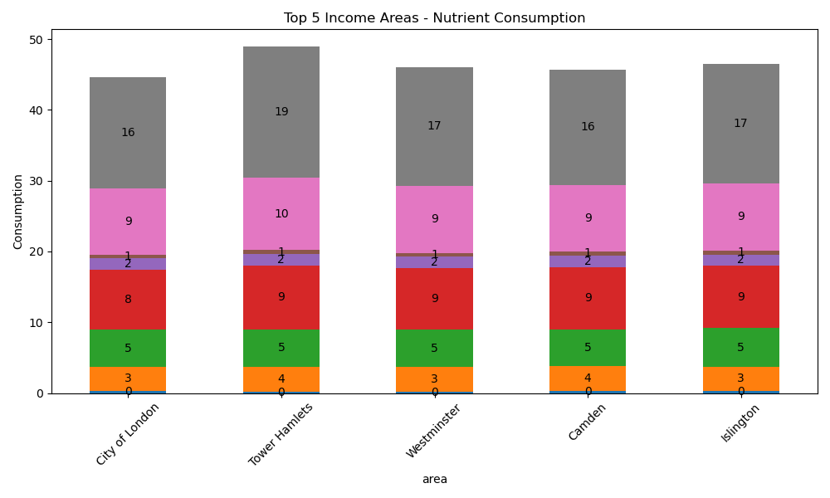
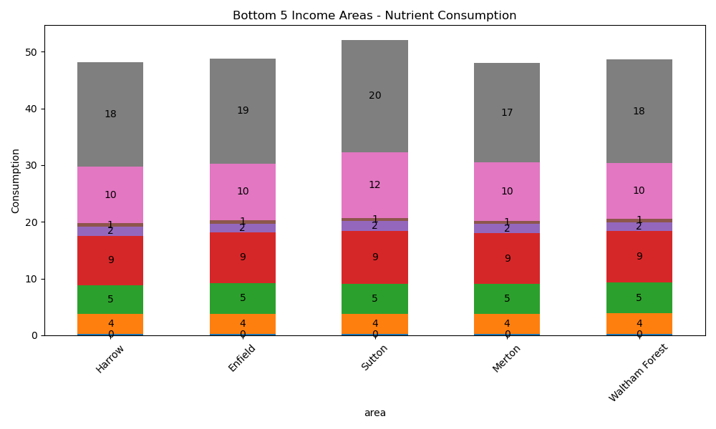
Nutrient consumptions
Averaged income from 2010 to 2015
Pearson Correlation on the nutrient data
Heatmap
Positive correlation
Alcohol and protein
Negative correlation
Saturate, fat, fibre and so on
Top and Bottom 5 income areas
Wealthier area
Less Carb, Sugar and Saturate
Lower income areas
Smaller budgets on healthy foods
More on sugar-sweetened beverages
Less nutritious frozen desserts
(French et al., 2019)
Notes:
I Averaged incomes from 2010 to 2015 to compared them with data on Tesco grocery purchases. I conducted The Pearson correlation analysis on nutrient data, heatmap was produced to illustrate the correlations.
This analysis showed wealthier areas consumed more alcohol and protein whereas poorer areas consumed more carbs sugars and saturates

Slide 25

Conclusion
Socio-Economic status – Dietary trends
High income
Versatile protein-rich diet
Cultural tradition, gatherings – Alcoholic beverages
Low income
Financial limitation
Processed and fast foods
Not only the amount of food available
Quality and variety of food
Notes:
In summary, our income analysis shows distinct eating habits tied to socio-economic status. Wealthier areas prefer more alcohol and protein, reflecting their diverse diets and social habits. In contrast, less affluent areas consume more sugar and fats, likely due to the affordability of processed foods. Thus, income shapes not just food quantity but quality as well.

Slide 26

Reference
French, S.A.,, Tangney, C.C.,, Crane, M.M.,, Wang, Y., and Appelhans, B.M., 2019. Nutrition quality of food purchases varies by household income: The shopper study. BMC Public Health, 19(1).

